Slide 1
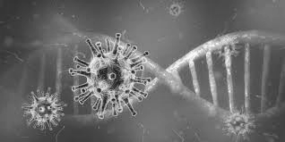
Covid19 Contact Tracer
By: Group 2
K.R.A.L Kahatapitiya (PGIS/CS/2020/21)
M.A.S Sandaruwan (PGIS/CS/2020/33)
S.T.I.C Wimladharma (PGIS/CS/2020/40)
Pamuditha Liyanage (PGIS/CS/2020/44)
W. M. R. P. K Weerasekara (PGIS/CS/2020/54)
S. Lathagini (PGIS/CS/2020/59)

Slide 2
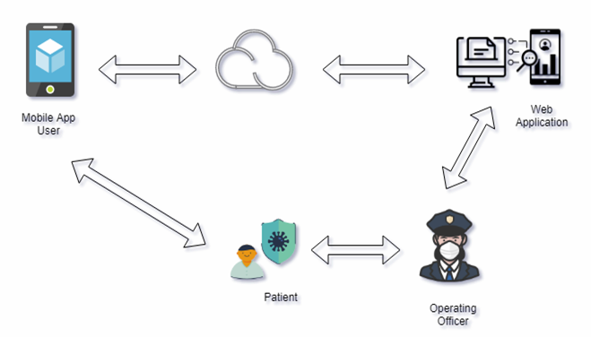
Content
Objective of project
Overview of our proposed system
Modules
Tools and Technology Used

Slide 3
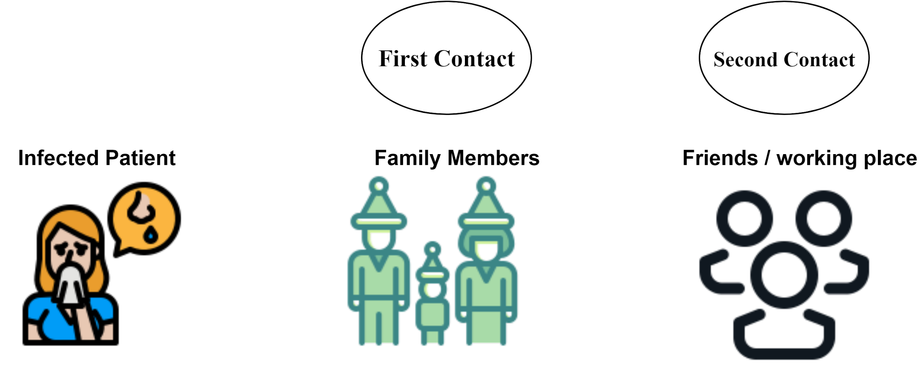
Objective of the project
Identify the person who really need to be quarantine and give proper instructions to them and get necessary actions to prevent spreading of Covid-19 within the society.

Slide 4
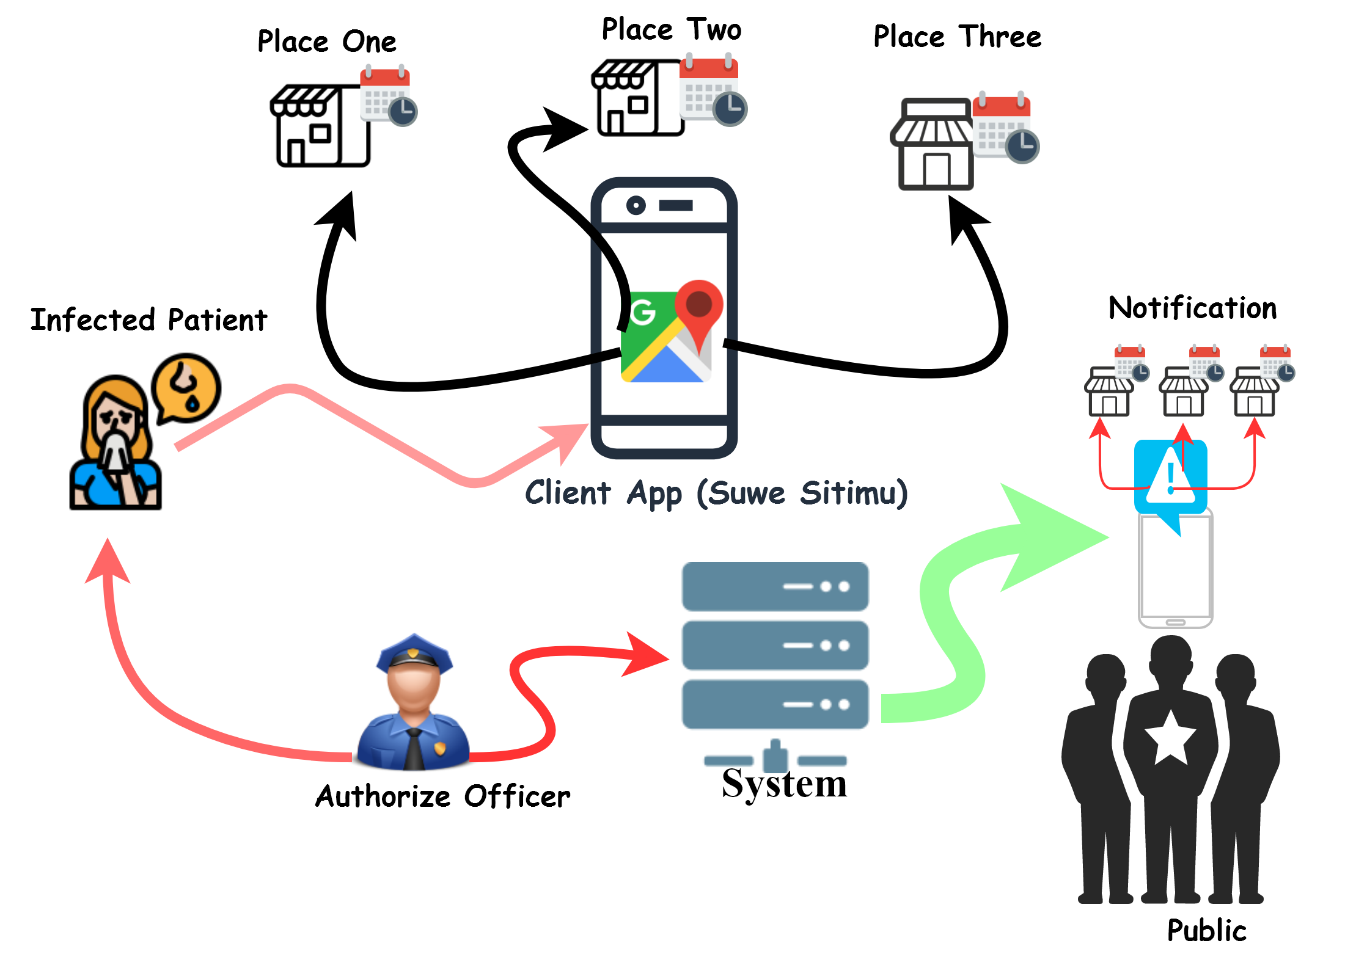
Overview of the proposed system

Slide 5
Modules in Abstract
User creation & registration
Patient (Covid positive) registration
Patient location records registration
Subscriber notification
Report generation

Slide 6
Tools and Technologies Used
Back-end: Java Spring Boot 2.5.4
Front-end:
Thymeleaf 3.0.12
Jquery 3.0.0
Bootstrap 4.4.1
Font Awesome 5.11.2
ChartJs
DB Server: MySql

Slide 7


Prarthana
Lathagini
Pamuditha
Sasika
Please use this Link to experience the system
https://covid19-contact-tracer-app.azurewebsites.net/login
Charitha
Lalith
Group 2

